Slide 1
SOA Exam FM
Module 3 – Section 5
Basic Bond Facts

Slide 2


Determining Bond Book Values
$$R$$
$$C$$
$$C$$
$$⋯$$
$$C$$
$$⋯$$
$$C$$
$$P$$
$$=Price$$
$$B_{k}$$
$$=book value just after k^{th} coupon$$

Slide 3
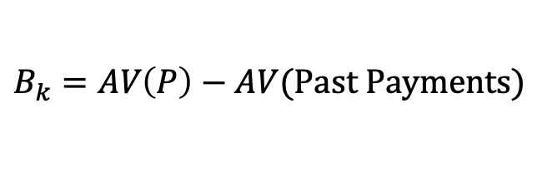

Determining Bond Book Values
$$R$$
$$C$$
$$C$$
$$⋯$$
$$C$$
$$⋯$$
$$C$$
$$P$$
$$=Price$$
$$B_{k}$$
$$=book value just after k^{th} coupon$$
$$(Retrospective)$$
$$B_{k}=AV\left(P\right)−AV(Past Payments)$$

Slide 4

Determining Bond Book Values
$$R$$
$$C$$
$$C$$
$$⋯$$
$$C$$
$$⋯$$
$$C$$
$$P$$
$$=Price$$
$$B_{k}$$
$$=book value just after k^{th} coupon$$
$$(Retrospective)$$
$$B_{k}=AV\left(P\right)−AV(Past Payments)$$
$$B_{k}=P{(1+i)}^{k}−C∙s_{\overline{k}|}$$

Slide 5


Determining Bond Book Values
$$R$$
$$C$$
$$C$$
$$⋯$$
$$C$$
$$⋯$$
$$C$$
$$P$$
$$=Price$$
$$B_{k}$$
$$=book value just after k^{th} coupon$$
$$(Retrospective)$$
$$B_{k}=AV\left(P\right)−AV(Past Payments)$$
$$B_{k}=P{(1+i)}^{k}−C∙s_{\overline{k}|}$$
$$(Prospective)$$
$$B_{k}=PV(Remaining Payments)$$

Slide 6

Determining Bond Book Values
$$R$$
$$C$$
$$C$$
$$⋯$$
$$C$$
$$⋯$$
$$C$$
$$P$$
$$=Price$$
$$B_{k}$$
$$=book value just after k^{th} coupon$$
$$(Retrospective)$$
$$B_{k}=AV\left(P\right)−AV(Past Payments)$$
$$B_{k}=P{(1+i)}^{k}−C∙s_{\overline{k}|}$$
$$(Prospective)$$
$$B_{k}=PV(Remaining Payments)$$
$$B_{k}=C∙a_{\overline{n−k}|}+R∙v^{n−k}$$

Slide 7

Determining Bond Book Values
$$R$$
$$C$$
$$C$$
$$⋯$$
$$C$$
$$⋯$$
$$C$$
$$P$$
$$=Price$$
$$B_{k}$$
$$=book value just after k^{th} coupon$$
$$P=B_{0}=C∙a_{\overline{n}|}+R∙v^{n}$$

Slide 8

$I_{k}$ and $P_{k}$

Slide 9
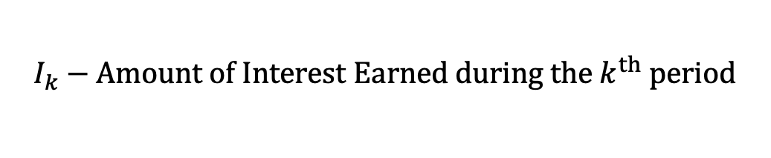
$I_{k}$ and $P_{k}$
$$I_{k}−Amount of Interest Earned during the k^{th} period$$

Slide 10

$I_{k}$ and $P_{k}$
$$I_{k}−Amount of Interest Earned during the k^{th} period$$
$$I_{k}=i∙B_{k−1}$$

Slide 11
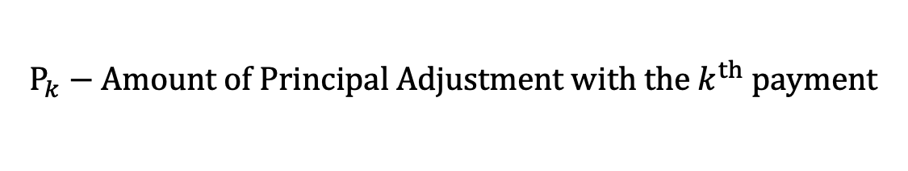
$I_{k}$ and $P_{k}$
$$I_{k}−Amount of Interest Earned during the k^{th} period$$
$$I_{k}=i∙B_{k−1}$$
$$P_{k}−Amount of Principal Adjustment with the k^{th} payment$$

Slide 12

$I_{k}$ and $P_{k}$
$$I_{k}−Amount of Interest Earned during the k^{th} period$$
$$I_{k}=i∙B_{k−1}$$
$$P_{k}−Amount of Principal Adjustment with the k^{th} payment$$
$$P_{k}=C−I_{k}$$

Slide 13



Balances at Neighboring Time Periods
$$I_{k}−Amount of Interest Earned during the k^{th} period$$
$$I_{k}=i∙B_{k−1}$$
$$P_{k}−Amount of Principal Adjustment with the k^{th} payment$$
$$P_{k}=C−I_{k}$$
$$C$$
$$B_{k−1}$$
$$B_{k}$$

Slide 14

Balances at Neighboring Time Periods
$$I_{k}−Amount of Interest Earned during the k^{th} period$$
$$I_{k}=i∙B_{k−1}$$
$$P_{k}−Amount of Principal Adjustment with the k^{th} payment$$
$$P_{k}=C−I_{k}$$
$$C$$
$$B_{k−1}$$
$$B_{k}$$
$$B_{k}=B_{k−1}∙\left(1+i\right)−C$$

Slide 15


Balances at Neighboring Time Periods
$$I_{k}−Amount of Interest Earned during the k^{th} period$$
$$I_{k}=i∙B_{k−1}$$
$$P_{k}−Amount of Principal Adjustment with the k^{th} payment$$
$$P_{k}=C−I_{k}$$
$$C$$
$$B_{k−1}$$
$$B_{k}$$
$$or$$
$$B_{k}=B_{k−1}∙\left(1+i\right)−C$$
$$B_{k}=B_{k−1}−P_{k}$$

Slide 16
$I_{k}$ and $P_{k}$
$$I_{k}−Amount of Interest Earned during the k^{th} period$$
$$I_{k}=i∙B_{k−1}$$
$$P_{k}−Amount of Principal Adjustment with the k^{th} payment$$
$$P_{k}=C−I_{k}$$

Slide 17
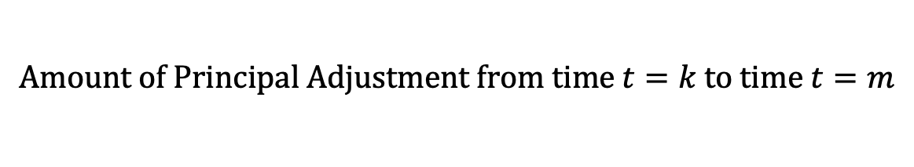
$I_{k}$ and $P_{k}$
$$I_{k}−Amount of Interest Earned during the k^{th} period$$
$$I_{k}=i∙B_{k−1}$$
$$P_{k}−Amount of Principal Adjustment with the k^{th} payment$$
$$P_{k}=C−I_{k}$$
$$Amount of Principal Adjustment from time t=k to time t=m$$

Slide 18


$I_{k}$ and $P_{k}$
$$I_{k}−Amount of Interest Earned during the k^{th} period$$
$$I_{k}=i∙B_{k−1}$$
$$P_{k}−Amount of Principal Adjustment with the k^{th} payment$$
$$P_{k}=C−I_{k}$$
$$Amount of Principal Adjustment from time t=k to time t=m$$
$$\sum_{j=k+1}^{m}{P_{j}}$$
$$=B_{k}−B_{m}$$

Slide 19
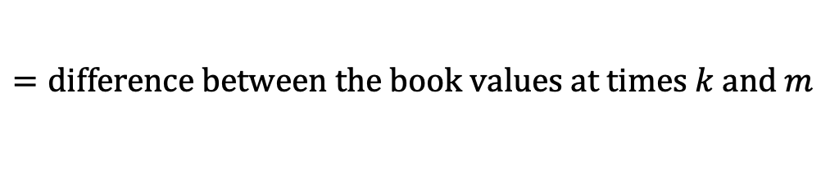
$I_{k}$ and $P_{k}$
$$I_{k}−Amount of Interest Earned during the k^{th} period$$
$$I_{k}=i∙B_{k−1}$$
$$P_{k}−Amount of Principal Adjustment with the k^{th} payment$$
$$P_{k}=C−I_{k}$$
$$Amount of Principal Adjustment from time t=k to time t=m$$
$$\sum_{j=k+1}^{m}{P_{j}}$$
$$=B_{k}−B_{m}$$
$$=difference between the book values at times k and m$$

Slide 20

$I_{k}$ and $P_{k}$
$$I_{k}−Amount of Interest Earned during the k^{th} period$$
$$I_{k}=i∙B_{k−1}$$
$$P_{k}−Amount of Principal Adjustment with the k^{th} payment$$
$$P_{k}=C−I_{k}$$
$$Amount of Principal Adjustment from time t=k to time t=m$$
$$\sum_{j=k+1}^{m}{P_{j}}$$
$$=B_{k}−B_{m}$$
$$=difference between the book values at times k and m$$
$$∴\sum_{j=1}^{n}{P_{j}}=B_{0}−B_{n}$$

Slide 21

$I_{k}$ and $P_{k}$
$$I_{k}−Amount of Interest Earned during the k^{th} period$$
$$I_{k}=i∙B_{k−1}$$
$$P_{k}−Amount of Principal Adjustment with the k^{th} payment$$
$$P_{k}=C−I_{k}$$
$$Amount of Principal Adjustment from time t=k to time t=m$$
$$\sum_{j=k+1}^{m}{P_{j}}$$
$$=B_{k}−B_{m}$$
$$=difference between the book values at times k and m$$
$$∴\sum_{j=1}^{n}{P_{j}}=B_{0}−B_{n}$$
$$LOANS: B_{0}−B_{n}=L−0=L$$

Slide 22

$I_{k}$ and $P_{k}$
$$I_{k}−Amount of Interest Earned during the k^{th} period$$
$$I_{k}=i∙B_{k−1}$$
$$P_{k}−Amount of Principal Adjustment with the k^{th} payment$$
$$P_{k}=C−I_{k}$$
$$Amount of Principal Adjustment from time t=k to time t=m$$
$$\sum_{j=k+1}^{m}{P_{j}}$$
$$=B_{k}−B_{m}$$
$$=difference between the book values at times k and m$$
$$∴\sum_{j=1}^{n}{P_{j}}=B_{0}−B_{n}$$
$$LOANS: B_{0}−B_{n}=L−0=L$$
$$BONDS: B_{0}−B_{n}=P−R$$

Slide 23
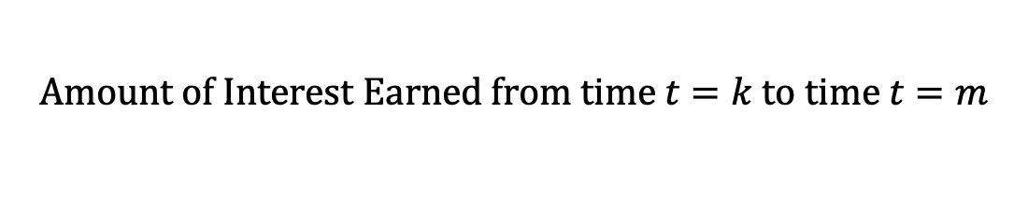
$I_{k}$ and $P_{k}$
$$I_{k}−Amount of Interest Earned during the k^{th} period$$
$$I_{k}=i∙B_{k−1}$$
$$P_{k}−Amount of Principal Adjustment with the k^{th} payment$$
$$P_{k}=C−I_{k}$$
$$Amount of Principal Adjustment from time t=k to time t=m$$
$$\sum_{j=k+1}^{m}{P_{j}}$$
$$=B_{k}−B_{m}$$
$$=difference between the book values at times k and m$$
$$Amount of Interest Earned from time t=k to time t=m$$

Slide 24



$I_{k}$ and $P_{k}$
$$I_{k}−Amount of Interest Earned during the k^{th} period$$
$$I_{k}=i∙B_{k−1}$$
$$P_{k}−Amount of Principal Adjustment with the k^{th} payment$$
$$P_{k}=C−I_{k}$$
$$Amount of Principal Adjustment from time t=k to time t=m$$
$$\sum_{j=k+1}^{m}{P_{j}}$$
$$=B_{k}−B_{m}$$
$$=difference between the book values at times k and m$$
$$Amount of Interest Earned from time t=k to time t=m$$
$$\sum_{j=k+1}^{m}{I_{j}}$$
$$=\sum_{j=k+1}^{m}{C} −$$
$$\sum_{j=k+1}^{m}{P_{j}}$$

Slide 25
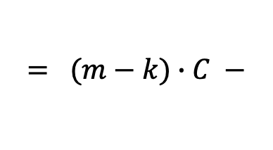
$I_{k}$ and $P_{k}$
$$I_{k}−Amount of Interest Earned during the k^{th} period$$
$$I_{k}=i∙B_{k−1}$$
$$P_{k}−Amount of Principal Adjustment with the k^{th} payment$$
$$P_{k}=C−I_{k}$$
$$Amount of Principal Adjustment from time t=k to time t=m$$
$$\sum_{j=k+1}^{m}{P_{j}}$$
$$=B_{k}−B_{m}$$
$$=difference between the book values at times k and m$$
$$Amount of Interest Earned from time t=k to time t=m$$
$$\sum_{j=k+1}^{m}{I_{j}}$$
$$\sum_{j=k+1}^{m}{P_{j}}$$
$$= (m−k)∙C −$$

Slide 26

$I_{k}$ and $P_{k}$
$$I_{k}−Amount of Interest Earned during the k^{th} period$$
$$I_{k}=i∙B_{k−1}$$
$$P_{k}−Amount of Principal Adjustment with the k^{th} payment$$
$$P_{k}=C−I_{k}$$
$$Amount of Principal Adjustment from time t=k to time t=m$$
$$\sum_{j=k+1}^{m}{P_{j}}$$
$$=B_{k}−B_{m}$$
$$=difference between the book values at times k and m$$
$$Amount of Interest Earned from time t=k to time t=m$$
$$\sum_{j=k+1}^{m}{I_{j}}$$
$$= (m−k)∙C −$$
$$(B_{k}−B_{m})$$

Slide 27
$I_{k}$ and $P_{k}$
$$I_{k}−Amount of Interest Earned during the k^{th} period$$
$$I_{k}=i∙B_{k−1}$$
$$P_{k}−Amount of Principal Adjustment with the k^{th} payment$$
$$P_{k}=C−I_{k}$$
$$Amount of Principal Adjustment from time t=k to time t=m$$
$$\sum_{j=k+1}^{m}{P_{j}}$$
$$=B_{k}−B_{m}$$
$$=difference between the book values at times k and m$$
$$Amount of Interest Earned from time t=k to time t=m$$
$$\sum_{j=k+1}^{m}{I_{j}}$$
$$=\left(\begin{aligned}the sum of the payments after time k \\ up to and including time m\end{aligned}\right)$$
$$= (m−k)∙C −$$
$$(B_{k}−B_{m})$$
$$−\left(\begin{aligned}the amount of principal adjustment \\ from time k to time m\end{aligned}\right)$$

